Slide 1


Aaryan Thusoo
June 29th 2025

Slide 2

Outline
Executive Summary
Introduction
Methodology
Results
Conclusion
Appendix

Slide 3
Executive Summary
Summary of methodologies
Summary of all results

Slide 4
Introduction
In this project, we are looking into the Falcon 9 rocket from SpaceX
Each launch is advertised to cost ~$62 million compared to the competitors ~$165 million charge
Due to SpaceX’s reusable first-stage equipment
Thus, finding if the first stage will land helps determine the cost of a launch
We want to determine based on previous launch data the factors which will provide the best chances of a successful launch
Project background and context
Problems you want to find answers

Slide 5

Section 1

Slide 6
Methodology
Executive Summary
Data collection methodology:
Data was collected through HTTP requests to the SpaceX API
Perform data wrangling
Data was processed by removing duplicates and missing values
Merged data sets and reset indexes to allow for proper organization
Perform exploratory data analysis (EDA) using visualization and SQL
Perform interactive visual analytics using Folium and Plotly Dash
Perform predictive analysis using classification models
How to build, tune, evaluate classification models

Slide 7
Data Collection
Used a request call to gather the launch data from SpaceX’s API in JSON format
Normalized JSON structure to flatten into tabular form
Converted data to Pandas DataFrame for more leisurely exploration
Filtered out important columns and successful launches
Cleaned or removed null values from data
Retrieve JSON from SpaceX API
Normalize JSON
Convert to DataFrame
Filter & Clean Columns

Slide 8
Data Collection – SpaceX API
Present your data collection with SpaceX REST calls using key phrases and flowcharts
Add the GitHub URL of the completed SpaceX API calls notebook (must include completed code cell and outcome cell), as an external reference and peer-review purpose
Place your flowchart of SpaceX API calls here

Slide 9
Data Collection - Scraping
Present your web scraping process using key phrases and flowcharts
Add the GitHub URL of the completed web scraping notebook, as an external reference and peer-review purpose
Place your flowchart of web scraping here

Slide 10
Data Wrangling
Dropped duplicates and missing values
Merged launch data with booster and landing outcome info
Transformed nested values
Reindexed the DataFrame for easier analysis

Slide 11
EDA with Data Visualization
Used:
Bar Charts – Focus on success rate of orbit and launch site landings
Scatter Plots – Measuring the relation between payload and launch outcome
Time Trend Plots – Look at launch success over the years
Purpose:
Understanding correlation between launch conditions and outcomes
Visualize patterns for model selection and feature engineering

Slide 12
EDA with SQL
SELECT DISTINCT launch site names
Find launch sites starting with ‘CCA’
Calculate total and average payload weights
Count successful vs failed missions
Rank landing outcomes by date range
Allowed me to explore dataset through SQL and confirm trend from visualization

Slide 13
Build an Interactive Map with Folium
Using Folium, generated a map focused on the launch sites of rockets in the United States
Generated markers for launch sites and added popups to show names
Circle markers were added around launch sites with either a green or red colour to indicate the success or failure of the launch
Calculated distances from sites to nearest coastline, railways, and highways
Drew lines or circles to visualize the distances
By adding these objects can explore the geospatial relationship between launch success and site characteristics
Helps in understanding how location may impact launch reliability or logistics

Slide 14
Build a Dashboard with Plotly Dash
Added
Dropdown menu to select a specific launch site
Pie chart measuring launch success and failure for selected sites
Range slider to filter launches by payload mass
Scatter plot of Payload Mass vs. Launch Outcome with colour-coded success and failure
Reason:
Allows users to explore by launch site
Interactive filtering allows easy test of payload impact
Scatter plot reveals trends between payload and mission success

Slide 15
Predictive Analysis (Classification)
Coded input features: launch site, orbit, payloads mass, booster version
Used OneHotEncoder to encode categorical variables
Split the data 80/20 into training and test sets
Used multiple classification models
Logistic regression, support vector machine, decision tree, random forest
Used GridSearchCV to find best hyperparameters
Evaluated models using:
Accuracy score, confusion matrix, and classification report
Random Forest returned the highest accuracy of ~93%

Slide 16
Results
Launch site and Orbit Type significantly affected mission success
Lower payload mass leads to higher landing success rate
F9 v1.2 Booster version showed consistently better performance

Slide 17

Section 2

Slide 18
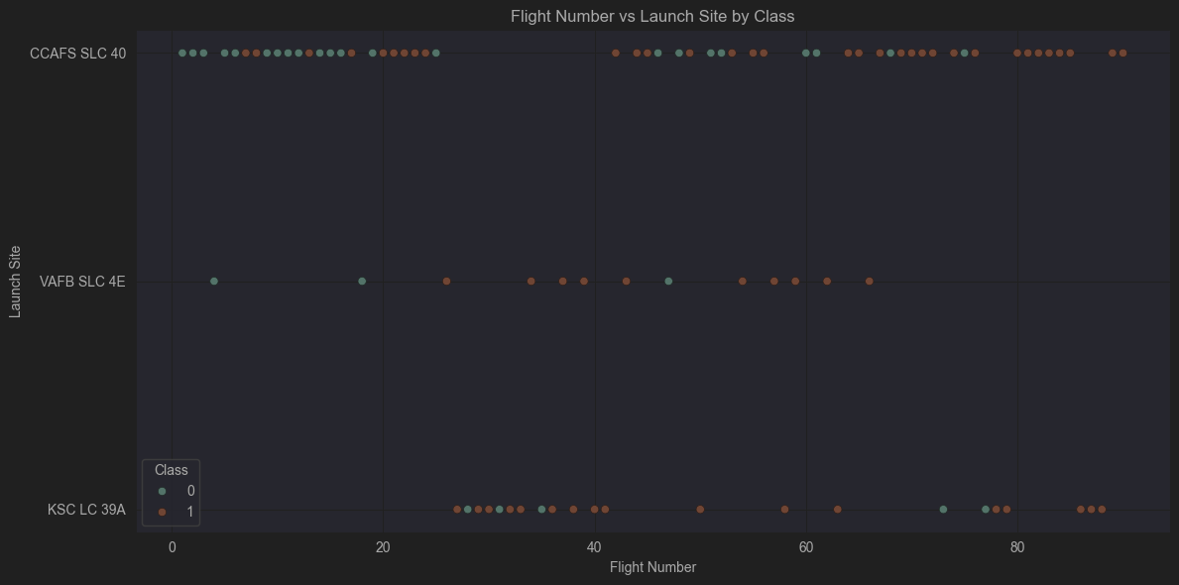
Flight Number vs. Launch Site
CCAFS SLC 40 had frequent early launches with mixed outcomes. As the flight numbers increase, the success rate improves, indicating growing mission reliability.
KSC LC 39A and VAFB SLC 4E appear primarily in later flights, suggesting they were used after operational experience had improved.
There is a clear trend of increasing success rate with higher flight numbers, which reflects the overall learning curve and technological enhancements over time.

Slide 19
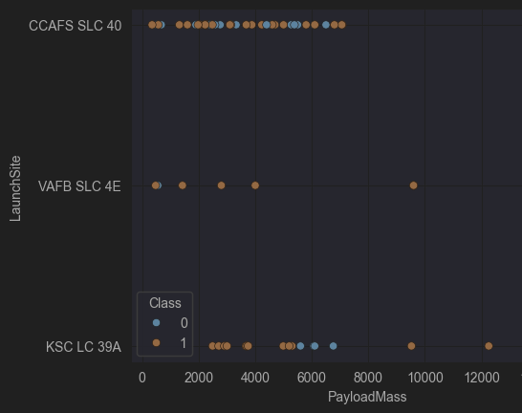
Payload vs. Launch Site
KSC LC 39A and VAFB SLC 4E mostly carried heavier payloads and show a high success rate, as indicated by the orange (Class = 1) points.
CCAFS SLC 40 has the widest spread of payload masses and includes a mix of successful and failed launches, suggesting it was used during the earlier phases of the program or for riskier missions.
Very heavy payloads (e.g. >10,000 kg) are mostly launched from KSC LC 39A, possibly due to its infrastructure and proximity to NASA resources.

Slide 20
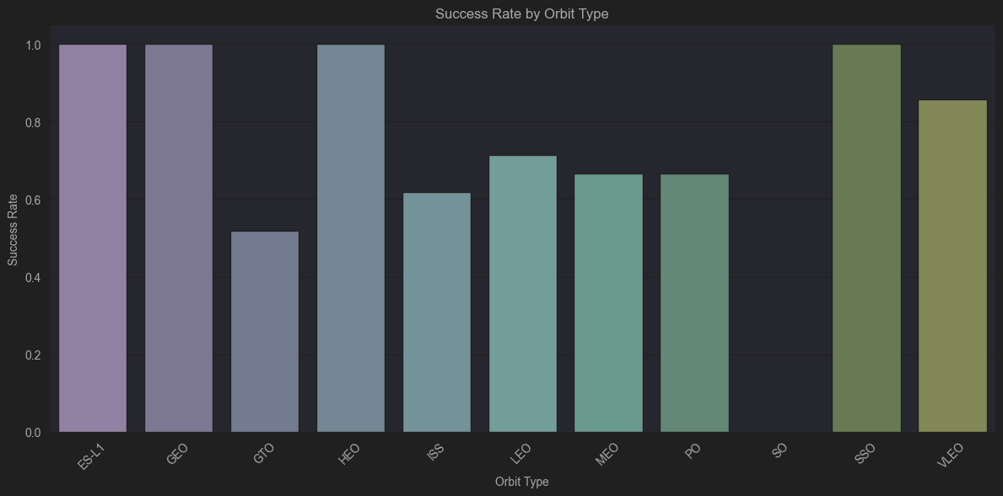
Success Rate vs. Orbit Type
ES-L1, GEO, HEO, and SSO all show 100% success rates, indicating highly reliable missions for these orbits—though this may also reflect a lower number of total launches.
GTO (Geostationary Transfer Orbit) has a notably lower success rate (~0.5), possibly due to its more complex or high-risk trajectories.
LEO, MEO, PO, and ISS show moderate success rates, indicating variability depending on mission parameters and time.

Slide 21
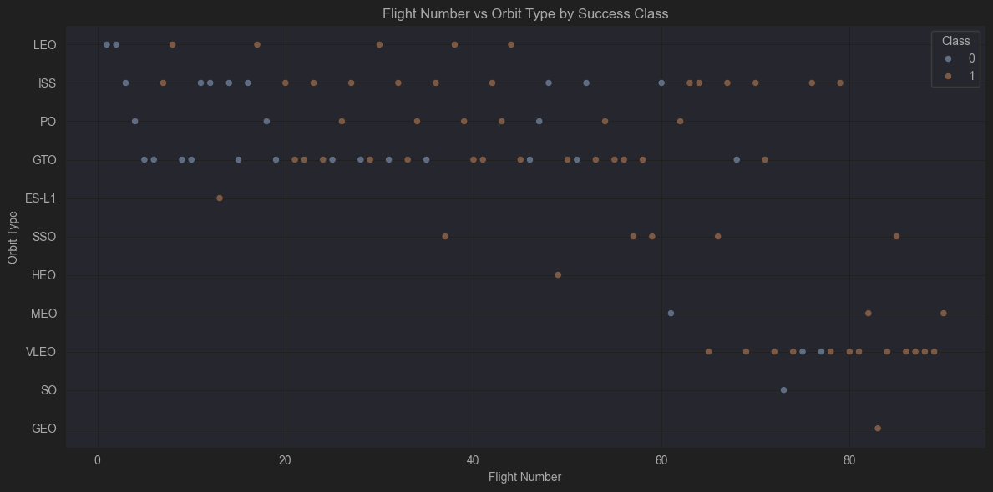
Flight Number vs. Orbit Type
Earlier flights (low flight numbers) had a higher proportion of failures across several orbit types, including LEO, ISS, and especially GTO, reflecting the learning curve in early Falcon 9 missions.
Over time (as Flight Number increases), successes dominate, particularly in orbits like SSO, VLEO, and GEO, which appear almost exclusively in later launches.
Some orbits like SSO, HEO, and GEO only appear in successful missions, but this may reflect a smaller sample size or strategic mission planning.
The transition from failure-heavy to mostly-successful launches across various orbit types demonstrates SpaceX’s increasing reliability with experience.

Slide 22
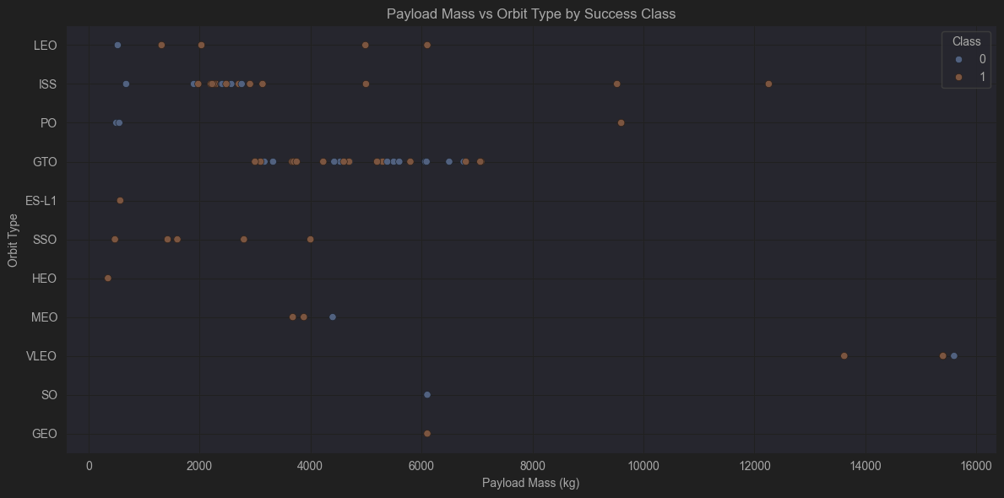
Payload vs. Orbit Type
GTO missions are associated with higher payload masses and show mixed success, highlighting the technical challenges of sending heavy payloads to high-energy orbits.
LEO, ISS, and PO missions involve lighter payloads and show a higher concentration of success, suggesting these are more routine or well-optimized missions.
GEO, HEO, and SSO show only successful launches, but with relatively lower sample counts, making it harder to generalize.
Payloads exceeding 10,000 kg were launched only in later flights and achieved 100% success, reflecting improvements in booster capability and mission reliability over time.

Slide 23

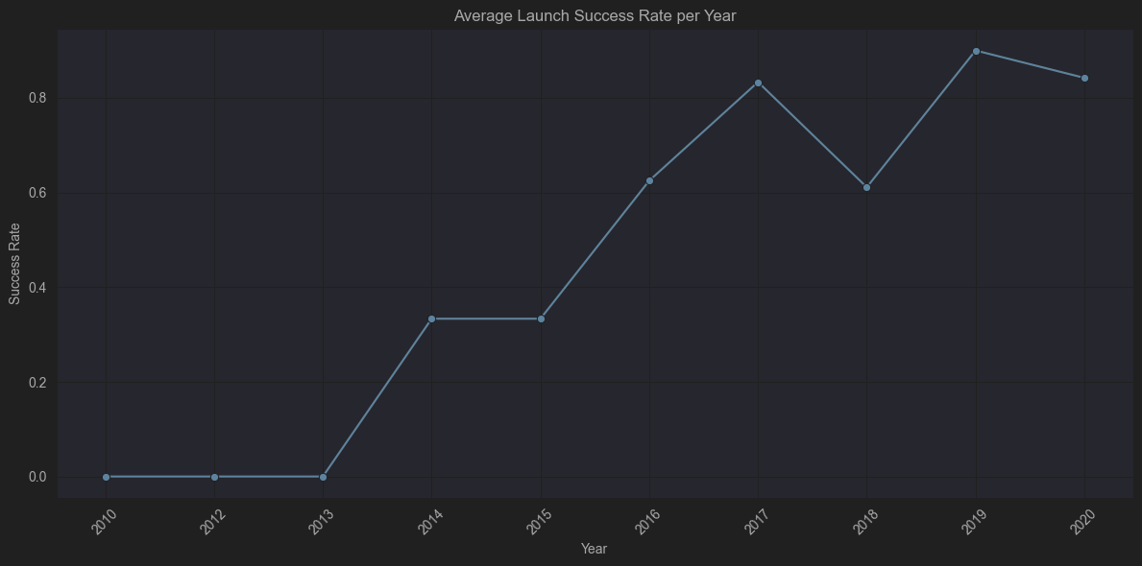
Launch Success Yearly Trend
The early years (2010–2013) show no successful launches, indicating the early experimental phase of Falcon 9.
A significant increase begins in 2014, with rapid improvements through 2017, where the success rate peaks above 80%.
A slight drop in 2018 may reflect mission complexity or operational anomalies, but success rebounds sharply in 2019, hitting its highest point.
The slight dip in 2020 still maintains a high average, reflecting overall operational maturity and reliability.

Slide 24
All Launch Site Names
There are three unique launch sites recorded in the dataset:
CCAFS SLC 40 – Cape Canaveral Air Force Station
VAFB SLC 4E – Vandenberg Air Force Base
KSC LC 39A – Kennedy Space Center
These launch sites are used for different mission profiles depending on orbit type, mission complexity, and payload mass. CCAFS has the highest number of launches, especially in earlier missions.

Slide 25
Launch Site Names Begin with 'CCA'
The query filters launch records where the launch site name starts with ‘CCA’ Cape Canaveral Air Force Station (CCAFS SLC 40).
This site was heavily used in the early phase of Falcon 9 missions. It handled a wide range of payload masses and orbit types. These sample records give a snapshot of its operational profile and are useful for trend or frequency analysis in launch site usage.

Slide 26
Total Payload Mass
The following Query was used:
SELECT SUM(PAYLOAD_MASS__KG_)
FROM SPACEXTABLE
WHERE CUSTOMER LIKE 'NASA (CRS)’;
This yields 45,596 kg, which is the total mass NASA contracted (“CRS”) missions have carried on Falcon 9 to date.

Slide 27
Average Payload Mass by F9 v1.1
The result was found with the query:
SELECT AVG(PAYLOAD_MASS__KG_) AS AvgPayloadF9v11
FROM SPACEXTABLE
WHERE BOOSTER_VERSION = 'F9 v1.1’;
This shows that, across all Falcon 9 v1.1 missions in our dataset, the mean payload mass was approximately 5 123 kg. It tells us that F9 v1.1 typically carried mid-sized payloads compared to earlier and later booster versions.

Slide 28
First Successful Ground Landing Date
For this result, the following query was used:
SELECT Date
FROM SPACEXTABLE
WHERE LANDING_OUTCOME = 'Success (ground pad)'
ORDER BY Date AS LIMIT 1;
This query finds the earliest date on which a SpaceX booster achieved a successful ground-pad landing. According to our data, the first ground-pad recovery occurred on 2016-12-21.

Slide 29
Successful Drone Ship Landing with Payload between 4000 and 6000
The result was found with the query:
SELECT DISTINCT BOOSTER_VERSION FROM SPACEXTABLE
WHERE LANDING_OUTCOME = 'Success (drone ship)'
AND PAYLOAD_MASS__KG_ BETWEEN 4000 AND 6000;
Here we list every Falcon booster version that successfully landed on a drone ship while carrying between 4,000 kg and 6,000 kg of payload. This shows which hardware configurations have been proven capable of mid-mass drone-ship recoveries.

Slide 30
Total Number of Successful and Failure Mission Outcomes
For this result, the following query was used:
SELECT CASE WHEN Class = 1 THEN 'Success'
ELSE 'Failure' END AS Outcome, COUNT(*) AS Count FROM SPACEXTABLE GROUP BY Class;
Out of 90 total launches, 76 were successful and 14 failed. This highlights SpaceX’s overall success rate (~84%) across all missions in the dataset.

Slide 31
Boosters Carried Maximum Payload
The result was found with the query:
SELECT DISTINCT Booster Version FROM SPACEXTABLE
WHERE Payload_Mass__KG_ = (SELECT MAX(Payload_Mass__KG_) FROM SPACEXTABLE);
The FT (Falcon 9 Full Thrust) booster version carried the single largest payload in our dataset. This indicates it has the highest lift capability among the versions analyzed.

Slide 32
2015 Launch Records
For this result, the following query was used:
SELECT LandingOutcome, Booster_Version, LaunchSite
FROM SPACEXTABLE
WHERE LandingOutcome = 'Failure (drone ship)'
AND Date BETWEEN '2015-01-01' AND '2015-12-31';
In 2015, these missions failed to land on the drone ship. Both failures occurred during early Falcon 9 v1.1 flights from Cape Canaveral (CCAFS SLC 40), reflecting the program’s early learning curve in recovering boosters at sea.

Slide 33
Rank Landing Outcomes Between 2010-06-04 and 2017-03-20
This query provides the wanted result:
SELECT LandingOutcome, COUNT(*) AS Count FROM SPACEXTABLE
WHERE Date BETWEEN '2010-06-04' AND '2017-03-20'
GROUP BY LandingOutcome ORDER BY Count DESC;
Between mid-2010 and early-2017, ground-pad recoveries were most frequent and successful, followed by drone-ship successes. Drone-ship failures outnumbered ground-pad failures, highlighting the greater difficulty of sea recoveries in that period.

Slide 34

Section 3

Slide 35
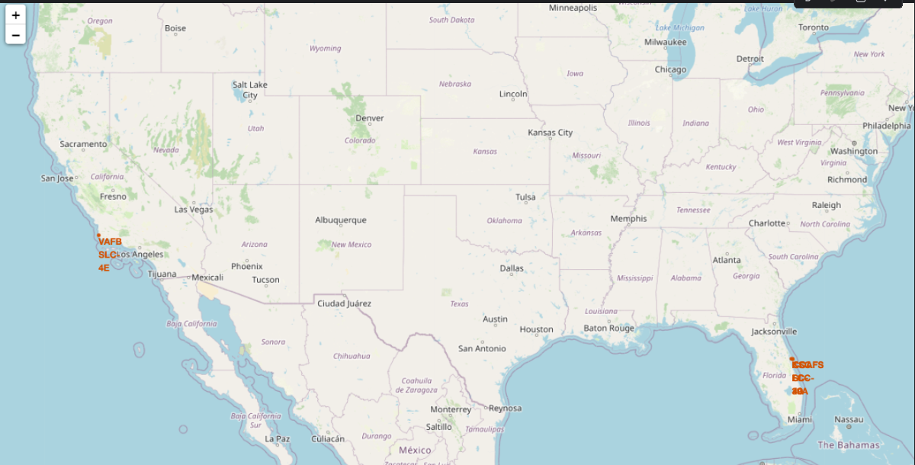
Launch Site Locations in the U.S. Map
This map shows the geographic positions of SpaceX’s two primary U.S. launch facilities:
VAFB SLC-4E on the California coast (West Coast operations)
CCAFS SLC-40 on Florida’s Space Coast (East Coast operations)
Clicking a marker reveals the site name in a popup for easy identification.
Visualizing sites on a national map highlights their strategic separation—enabling polar launches from Vandenberg (VAFB) and equatorial/GTO missions from Cape Canaveral (CCAFS).

Slide 36
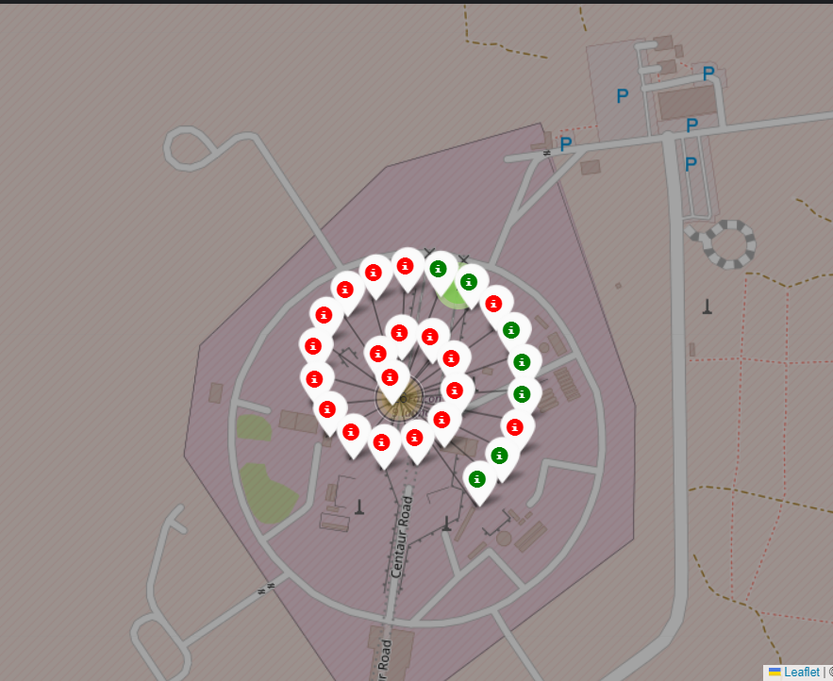
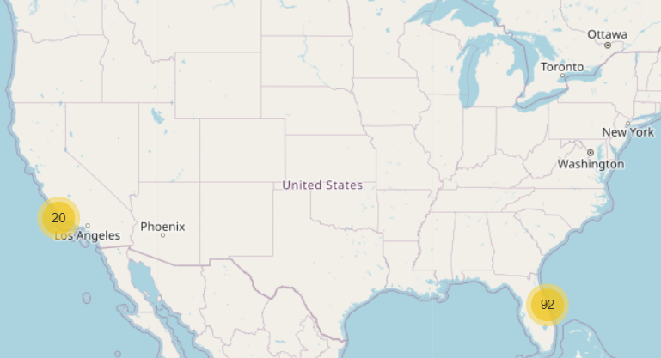
Launch Site Activity and Outcomes
The cluster view shows total launches by site—92 at CCAFS SLC-40 versus 20 at VAFB SLC-4E—while the zoomed-in Vandenberg pad map plots each flight’s outcome (red = failure, green = success), illustrating how early mixed results gave way to near-perfect reliability over successive missions.

Slide 37
<Folium Map Screenshot 3>
Replace <Folium map screenshot 3> title with an appropriate title
Explore the generated folium map and show the screenshot of a selected launch site to its proximities such as railway, highway, coastline, with distance calculated and displayed
Explain the important elements and findings on the screenshot

Slide 38

Section 4

Slide 39
<Dashboard Screenshot 1>
Replace <Dashboard screenshot 1> title with an appropriate title
Show the screenshot of launch success count for all sites, in a piechart
Explain the important elements and findings on the screenshot

Slide 40
<Dashboard Screenshot 2>
Replace <Dashboard screenshot 2> title with an appropriate title
Show the screenshot of the piechart for the launch site with highest launch success ratio
Explain the important elements and findings on the screenshot

Slide 41
<Dashboard Screenshot 3>
Replace <Dashboard screenshot 3> title with an appropriate title
Show screenshots of Payload vs. Launch Outcome scatter plot for all sites, with different payload selected in the range slider
Explain the important elements and findings on the screenshot, such as which payload range or booster version have the largest success rate, etc.

Slide 42

Section 5

Slide 43
Classification Accuracy
Visualize the built model accuracy for all built classification models, in a bar chart
Find which model has the highest classification accuracy

Slide 44
Confusion Matrix
Show the confusion matrix of the best performing model with an explanation

Slide 45
Conclusions
Point 1
Point 2
Point 3
Point 4
…

Slide 46
Appendix
Include any relevant assets like Python code snippets, SQL queries, charts, Notebook outputs, or data sets that you may have created during this project

Slide 47


